Slide 1
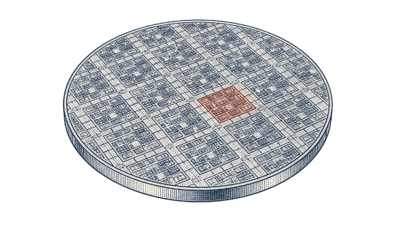
IEEE IDLP GEORGIA INSTITUTE OF TECHNOLOGY
Deep Topological Data Analysis for Semiconductor Data Mining
Persistent homology, deep learning, and statistical inference from foundations to silicon
Janhavi Giri, PhD · Principal Architect, Field CTO · NetApp
October 2026

Slide 2
Outline
Why shape, for IC data?
Mathematical foundations
The DTDA framework
Deployment patterns
Architecture and complexity
Takeaways and Q&A
Bonus

Slide 3
PART 1 · MOTIVATION
Why shape, for IC data?
High-dimensional, nonlinear design and manufacturing spaces obscure failures when projected blindly.
“The greatest value of a picture is when it forces us to notice what we never expected to see” John Tukey, 1977, American Mathematician and Statistician
1

Slide 4
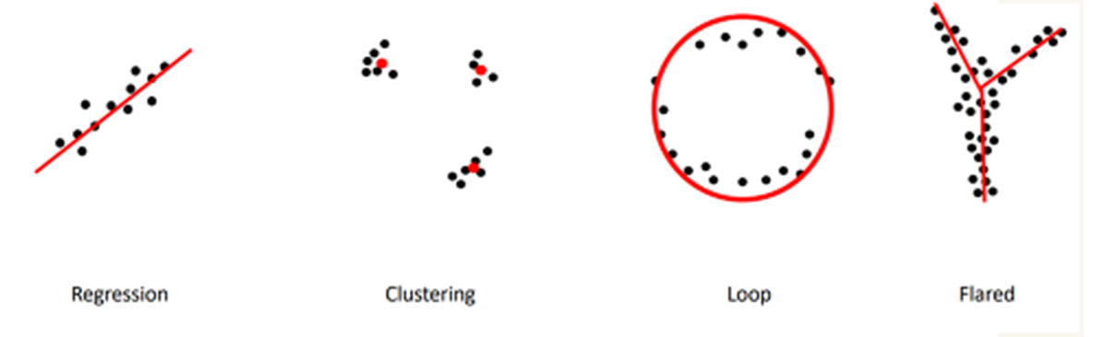
Topological Data Analysis
“Data has shape and the shape matters” — Prof. Gunnar Carlsson
Regression · Clustering · Loop · Flared: different data shapes need different tools.

Slide 5
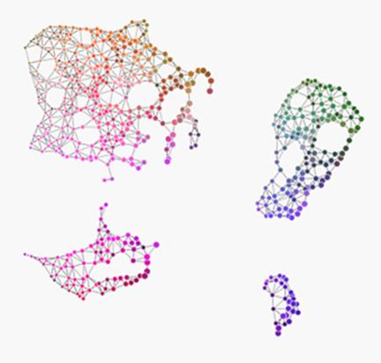
From raw IC data to a topological map
Images
Wafer maps, SEM, layout clips
Logs & traces
TDA
Tool-sensor and recipe traces
Test tables
Each node is a cluster of similar samples; edges link clusters that share data. Branches and loops show structure that flat clustering misses.
Parametric and high-dimensional

Slide 6
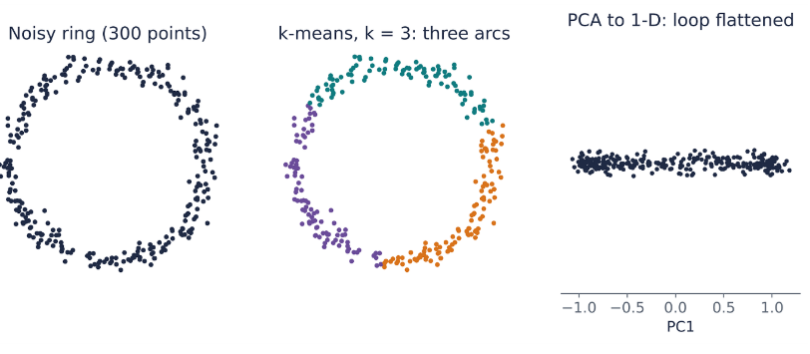
Standard tools can miss the shape that matters
Clustering answers 'which group?' and imposes k groups on one ring
Linear projection answers 'which direction varies most?' and flattens loops
Missing question: is there a loop, a void, a branch, and is it real?

Slide 7
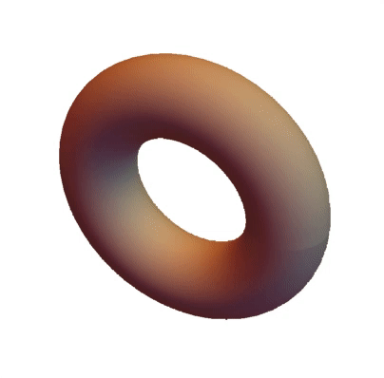
Topology keeps what survives continuous deformation
Stretching or bending does not change these counts; tearing or gluing does. A mug and a donut share b = (1, 2, 1).
BETTI NUMBERS OF REFERENCE SHAPES
Shape | b0 components | b1 loops | b2 voids
Point / blob | 1 | 0 | 0
Circle | 1 | 1 | 0
Figure-eight | 1 | 2 | 0
Sphere surface | 1 | 0 | 1
Torus surface (donut, mug) | 1 | 2 | 1
https://summergeometry.org/sgi2021/is-it-a-donut-or-is-it-a-mug/
A finite sample has b0 = n and no loops, so we must choose a scale or study all scales at once.

Slide 8
Where shape shows up in design and manufacturing data
SPATIAL & PHYSICAL DOMAINS
TEMPORAL & OPTICAL SIGNALS
PARAMETRIC & COMPLEX CHOICE
Wafer maps
Sensor traces
Parametric test
Defect clusters identify as connected components ( ), scratch lines, and spatial thermal rings ( ).
Periodic etch and CVD recipe steps manifest as limit cycles in Takens delay embeddings and sensor-correlation networks.
E-test parameter correlations reveal multi-modal operational regimes and yield drop bifurcations via Mapper graphs.
SEM & inspection
Layout clips
Natural Complex
Topological contacts, bridging defects, and open vias tracked through persistent multi-scale thresholding.
Printed geometries, pinholes, and enclosed void spaces evaluated as functions of optical dose and resist threshold.
Point clouds → Vietoris–Rips · images → cubical · tables → Mapper

Slide 9
What TDA can, and cannot, do for you
CAN
CANNOT
summarize connectivity, loops and voids across all scales
work from distances only, with stability guarantees, and produce features for standard ML
compress high-dimensional data into a navigable graph (Mapper)
explain what a feature means, or give significance automatically (Fasy et al., 2014)
scale to millions of points without subsampling, rescue a poor metric, or replace clustering and regression

Slide 10
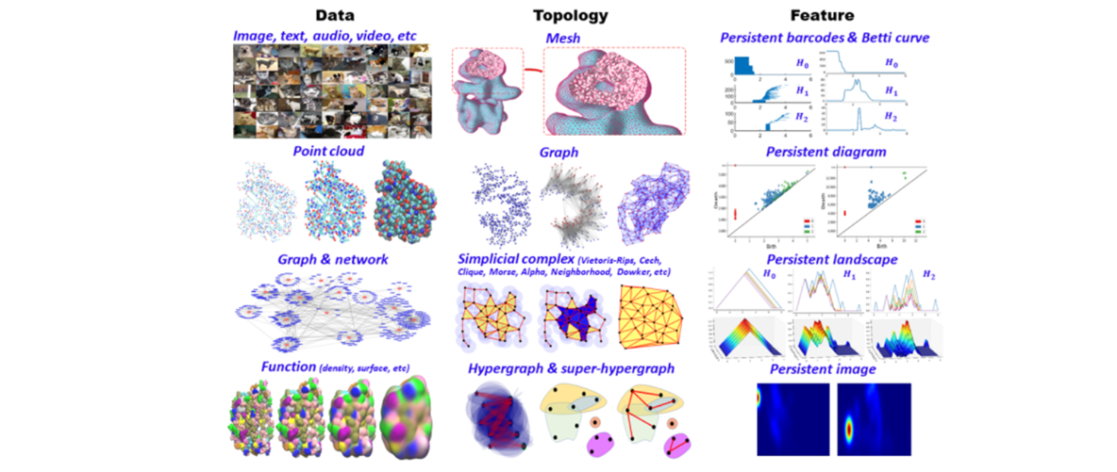
TDA Workflow
Aspects of topological approaches for data science (aimsciences.org)

Slide 11
PART 2
Mathematical foundations
Point clouds and complexes · filtrations · birth, death and persistence · cubical complexes for images · stability
2

Slide 12
Data representation and distance
Observations
Rows represent wafers, layout clips or time windows. Features or embeddings define their representation.
Distance
Standardize relevant features, then choose a distance that reflects process similarity. The choice changes topology.
Construction
Point clouds: Vietoris–Rips. Images: cubical complexes. Tables: Mapper graphs for exploration.
Scale
A filtration varies a threshold ε. Persistent homology tracks features across the resulting nested complexes.

Slide 13
Complexes and homology
Building blocks
A vertex is a point. Edges join pairs. Filled triangles and tetrahedra represent higher-order connections.
Vietoris–Rips
Include a simplex when every pair of its vertices has distance ≤ ε. Increasing ε produces nested complexes.
H0, H1, H2
H0 tracks connected components. H1 tracks unfilled loops. H2 tracks enclosed cavities.
Betti numbers
βk counts independent features in dimension k at a chosen scale. Persistence records how those features change.

Slide 14
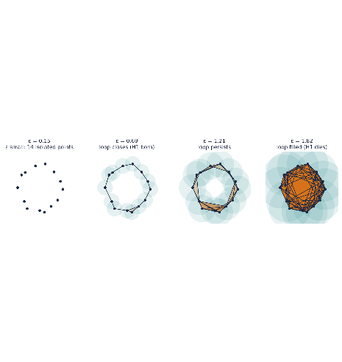
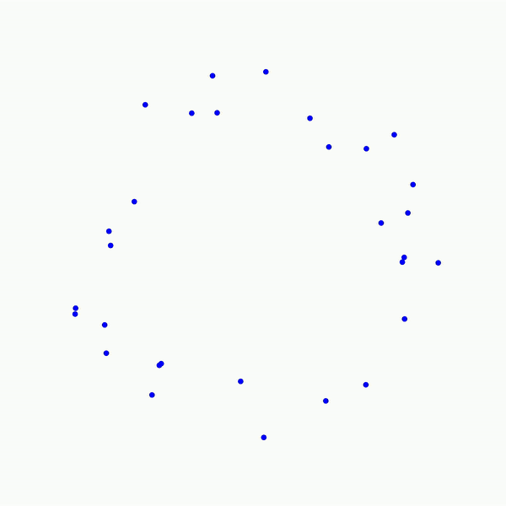
Grow ε and watch the complex build up
Nested: every complex contains the previous one
Computed, not drawn: for these 14 points, ripser reports one loop born at ε ≈ 0.67 that dies at ε ≈ 1.74
One pass, all scales: every birth and death recorded in a single sweep
Vietoris-Rips algorithm animation: https://towardsdatascience.com/the-shape-that-survives-the-noise-f0a2a89018c6

Slide 15
Birth, death and persistence
Persistence = death − birth
Birth
The threshold at which a new component, loop or cavity appears.
Death
A component merges into an older one, or a loop or cavity fills. Some features never die within the filtration.
Example
For the 14-point ring: birth ≈ 0.67, death ≈ 1.74, persistence ≈ 1.07.
Long persistence indicates survival across scales. Statistical significance requires a separate test.

Slide 16
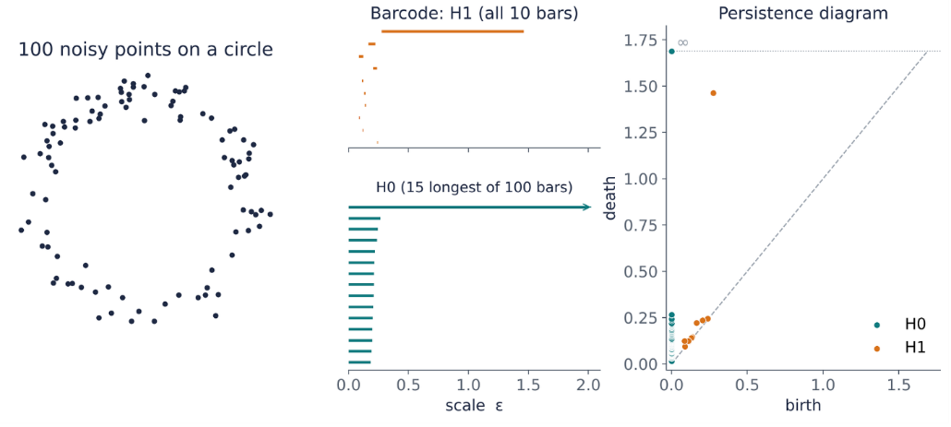
Two equivalent pictures of the same information
Barcode: one bar per feature, [birth, death)
Diagram: one point per feature, (birth, death)
This run: longest H1 bar 1.19; next longest 0.06

Slide 17
Conditions for a trustworthy topological signal
Stability
For sublevel-set persistence, small uniform changes in the function bound changes in the persistence diagram.
Model sensitivity
Repeat with sensible scaling, metrics and subsamples. Density gaps, outliers and embeddings can distort structure.
Statistical evidence
Compare persistence with an appropriate null model. Calibrate thresholds on held-out normal data and monitor false alarms.
Physical meaning
Connect features to wafer locations or process history. Topological similarity supplies a hypothesis for engineering validation.

Slide 18
PART 3
The Deep TDA (DTDA) framework
Persistent homology + deep learning + statistical inference · vectorisation · learned topological layers · Mapper for exploration
3

Slide 19
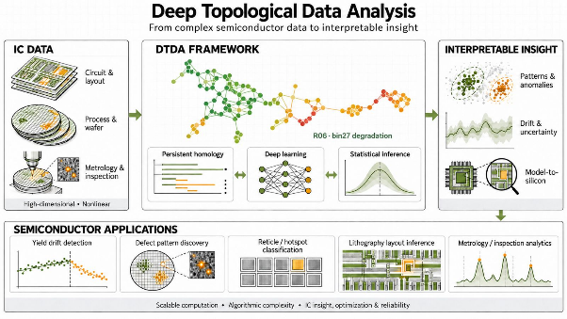
A hybrid pipeline: topology, deep learning and inference
IC data: wafer maps, SEM, layout clips, sensor traces, test tables
Topological encoding: Rips (point clouds) · cubical (images) · Mapper (tables)
Vectorise: statistics · landscapes · persistence images · learned layers
Deep learning: fuse with CNN / self-supervised embeddings; transfer learning
Inference: calibrated thresholds, confidence sets, false-alarm control
Engineering loop: root-cause analysis · excursion and drift alerts · defect-pattern triage · hotspot review · feedback to process and design. Giri & Lengyel (2023); Giri, Lengyel, Kent & Kibardin (2025, arXiv:2505.03848).

Slide 20
PART 4
Deployment patterns in IC data
Yield drift detection · defect-pattern discovery · lithography layout inference · hotspot classification · metrology and inspection analytics
4

Slide 21
Two published DTDA variants
SPEAKER'S WORK
2023 · Yield and quality root cause: wafer-fab data that is high-dimensional, sparse and imbalanced; graphs whose nodes are clusters of similar samples and edges mark overlapping characteristics; identifies features behind yield and quality issues
2025 · Semiconductor image clustering: deep TDA with self-supervised and transfer learning; validated on synthetic and open-source datasets; clusters aligned with defect patterns and process variations
Giri & Lengyel (2023), ASME InterPACK, V001T08A001; Giri et al. (2025), arXiv:2505.03848.

Slide 22
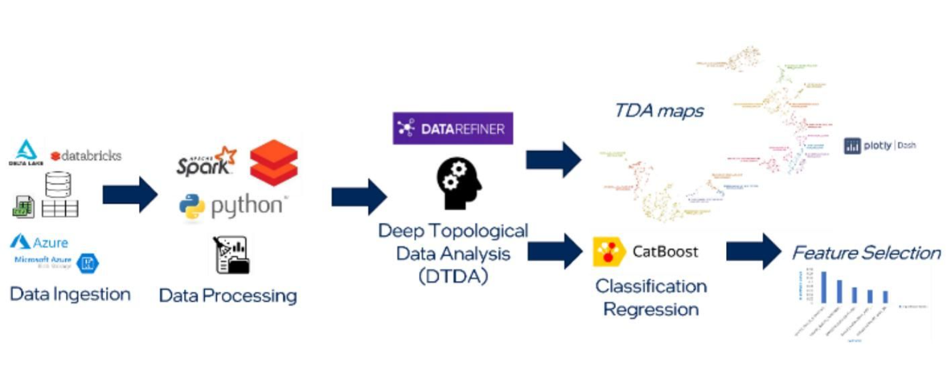
The analytics pipeline: from data ingestion to feature selection
Giri & Lengyel (2023), ASME InterPACK, Fig. 1

Slide 23
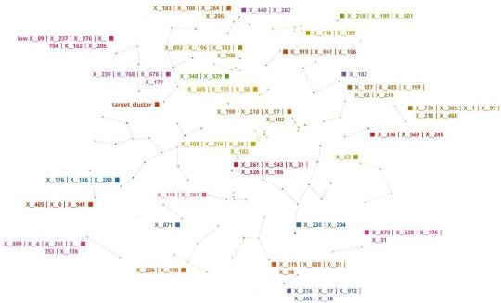
Use case 1: 15 failing wafers among 2,952
Data: 2,952 wafers × 974 process-flow variables, including 15 failures (0.5%)
Inputs: operating conditions, equipment units, time spans and sensor parameters
Target: 1 = fail, 0 = pass, overlaid after unsupervised clustering
Question: do failed wafers occupy a distinct region of the map?
Result: all 15 failures appear in one target cluster. Process validation is needed to establish causality
Figure 3: topological map; nodes = wafer-sample clusters, edges = overlapping characteristics
Giri & Lengyel (2023), ASME InterPACK, Fig. 3

Slide 24
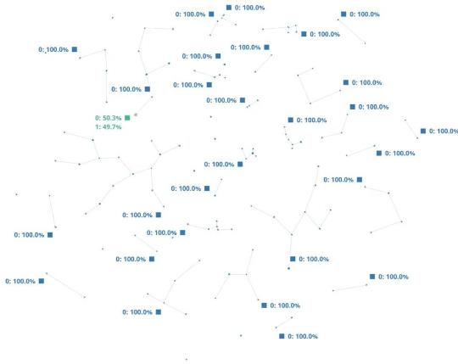
All 15 failed wafers fall in one cluster
Overlaying the target shows that 100% of failed wafers aggregate into one cluster (green).
Distribution of target in each cluster; the target cluster (green) contains the 15 failed wafers.
Giri & Lengyel (2023), ASME InterPACK, Fig. 4

Slide 25
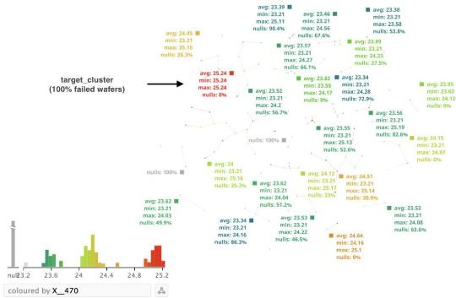
One feature, X_470, separates the failing cluster
Top feature: X_470 is the top contributing feature for the data separation
The target cluster (100% failed wafers) sits at the maximum value of X_470 (25.24, with 0% nulls); other clusters average about 23.2–24.6
Zooming into the target cluster, the features and combinations behind the clustering were X_101, X_156, X_517, X_452, X_679 and others
Coloured by X_470; grey = null values, red = maximum value.
Giri & Lengyel (2023), ASME InterPACK, Fig. 5

Slide 26
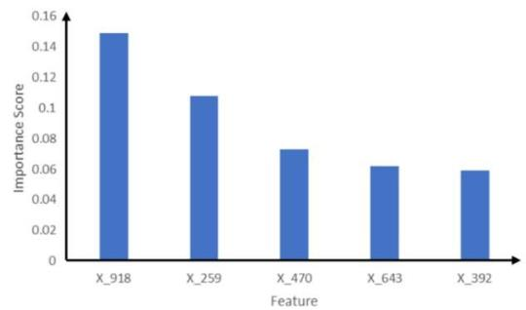
Supervised check: which features drive failure
CatBoost (gradient boosting on decision trees) was applied to see which features matter to the outcome (failed vs normal).
Top features by importance: X_918 (~0.15), X_259 (~0.11), X_470 (~0.075), X_643 (~0.065), X_392 (~0.06)
Process owners confirmed these features as top contributors to the observed failures.
Higher score = larger impact on the outcome. Bar values are read from the chart and approximate.
Giri & Lengyel (2023), ASME InterPACK, Fig. 6

Slide 27
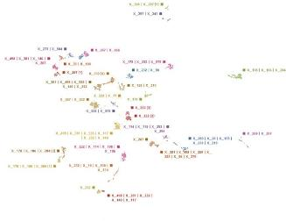
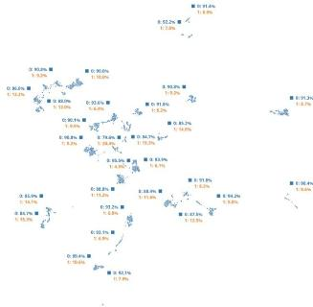
Use case 2: failures spread across the map
Data: 11,468 wafers × 962 process-flow steps, including 1,137 failing wafers
Observation: failures span multiple clusters, with cluster failure rates of roughly 4.5%–20.4%
Interpretation: this map shows no single failure cluster. It does not establish that useful predictors are absent
Next step: check data coverage, time effects and Mapper settings. Test predictive signal with held-out data
Giri & Lengyel (2023), ASME InterPACK, Fig. 7
Giri & Lengyel (2023), ASME InterPACK, Fig. 8

Slide 28
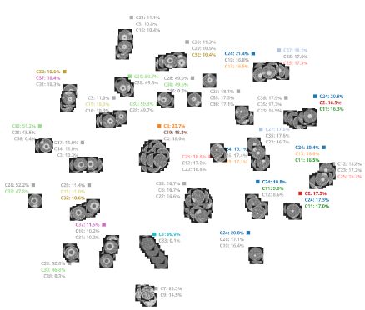
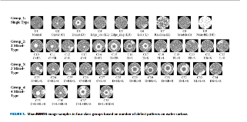
Deep TDA + self-supervised learning for image analytics
IMAGES
MODEL
TDA MAP (CLUSTERS & LABELS)
Deep Topological
Data Analysis (DTDA)
→
=
+
Self-Supervised
Learning (SSL)

Slide 29
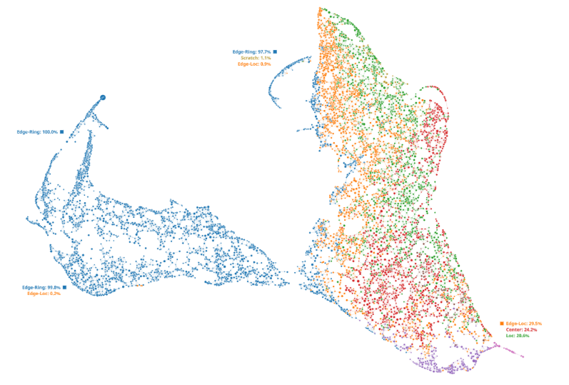
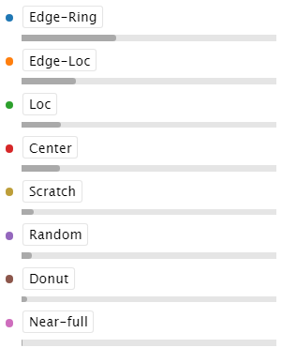
Image segmentation of WM811K wafer maps
Clusters based on defects
TDA Map
4 Clusters with % distribution of a defect in each cluster

Slide 30
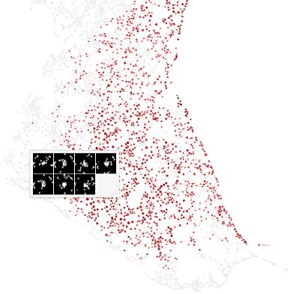
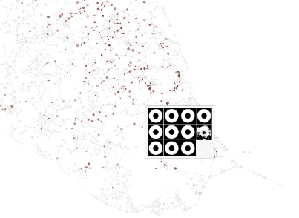
Analyzing individual segments per defect type
Near Full
Center
Donut

Slide 31
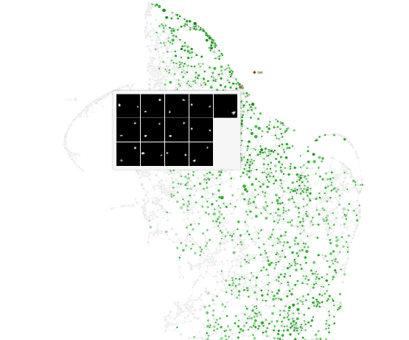
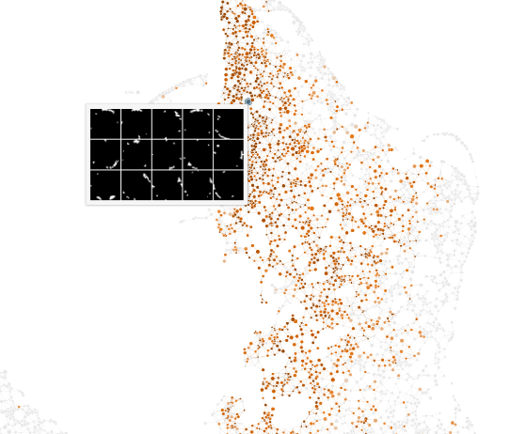
Analyzing segments per defect type (cont.)
Loc
Edge-Loc

Slide 32
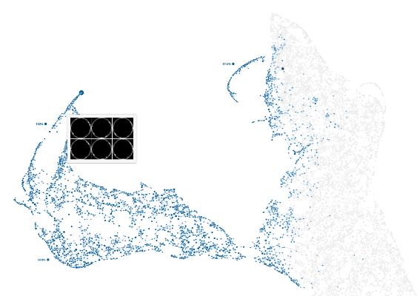
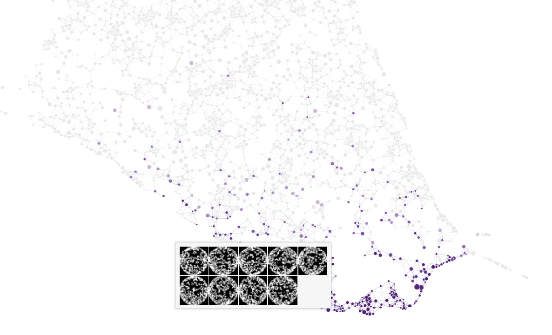
Analyzing segments per defect type (cont.)
Edge-Ring
Near-Full

Slide 33
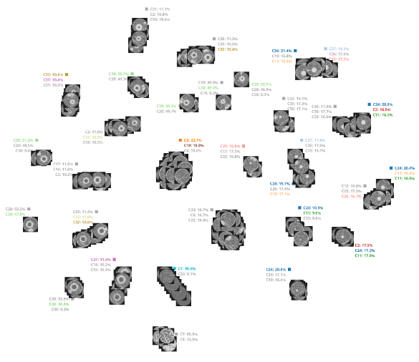
Image segmentation of MixedWM38 wafer maps
TDA MAP
31 clusters
Single and Mixed categories
Topology separates normal structure from mixed defect patterns.
normal
Near-full and Random

Slide 34
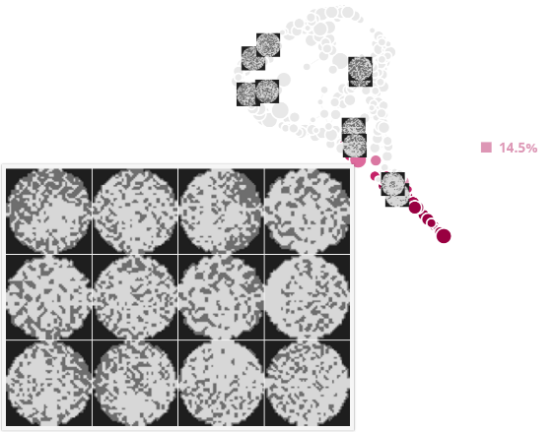
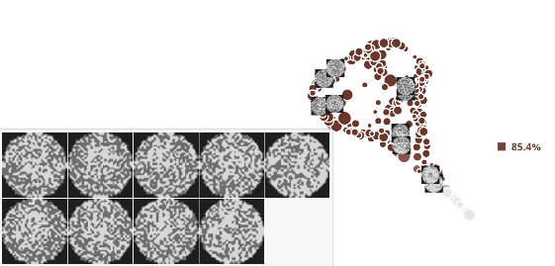
Image segmentation results for single-type defects
C7 · Near-full cluster
C9 · Random cluster

Slide 35
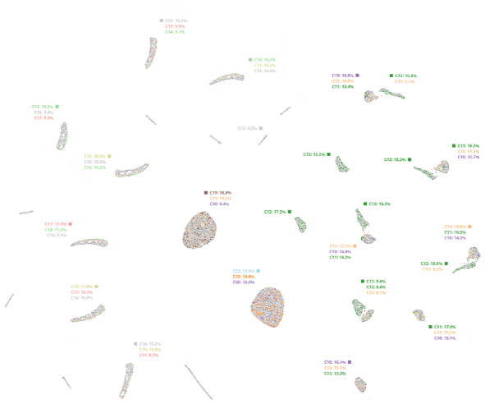
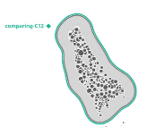
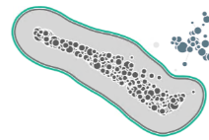
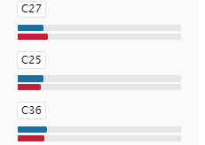
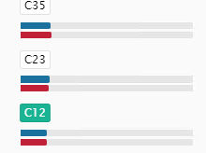
Image segmentation results: C10–C22 Mixed Type 2
Distribution of Type 2 categories
Comparing two clusters for C12 (Center + Local)
VS
Different
Same
None
Same defect class, different morphology
1 sub-type
rest
> 1 sub-type

Slide 36
PART 5
Architecture, complexity and interpretability
Design choices · algorithmic cost with measured timings · build vs buy · tracing model output back to silicon
5

Slide 37
Six decisions that shape a DTDA system
Representation: Rips · cubical · Mapper, matched to the data type
Filtration function: distance, intensity, correlation or model score
Vectorisation: fixed (stats, landscapes, images) or learned layers
Fusion point: early concatenation with embeddings, or late combination
Inference: calibrated thresholds; false-alarm rate on held-out normal data
Deployment cadence: batch per lot or wafer · streaming windows · cache diagrams · landmarks

Slide 38
Strengths, weaknesses, and when to choose it
Strengths: coordinate-free · stable under small noise · global, multi-scale structure
Weaknesses: cost grows fast with n and dimension · interpretation needs care · vectorisation needed for ML
WHEN TO REACH FOR TDA
Your question | Reach for | TDA adds
Which group does each point belong to? | Clustering | H0 barcode shows at what scale clusters merge
What does the data look like in 2-D? | PCA / UMAP | Check that loops or branches are real
Relations are given as edges | Graph analytics | Persistence on graph distances or weights
Are there loops, voids, multi-scale structure? | Persistent homology | Core use case
What is the global map, with branches? | Mapper | Core use case

Slide 39
Build vs Buy: Evaluation of TDA engines
Features | Open-source software | Vendor Ayasdi * | Vendor DataRefiner
Complexity | High; requires users to pick parameters; trial and error | High; many parameters to select; result sensitive to chosen parameters | Low; small, well-explained model parameters
Easy to understand | Some documentation available | Obscure algorithms | Not a black box; documentation available
Data preparation | Manual | Manual; not part of the platform | Automated; performed in the platform
Data volume | Cannot handle big data; software crashes | Struggles for data with over 5 million rows and ~200 columns | Supports 30 million rows and 100k columns
Data verifications | Manual | None | Automated; performed in the platform
Model selection | Manual | None | Automated; picks the best one and shows the intermediate ones for user customization if needed
Automatic cluster naming | None | None | Automated; meaningful names representing relevant parameters
Enterprise readiness | No clear ownership and not up to date with latest developments | Rebranded; currently servicing Financial Industry | Yes; customers across multiple domains
Applicability to real world use case | Mostly R&D; for POCs | Yes | Yes
* Product no longer available in market
Giri & Lengyel (2023), ASME InterPACK

Slide 40
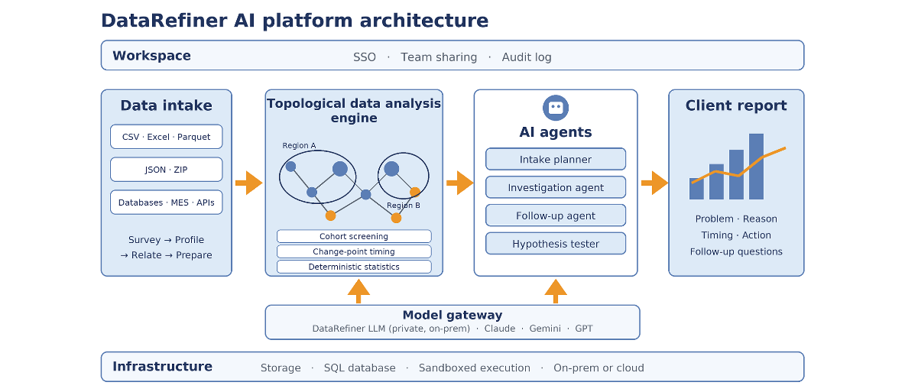
Agentic TDA Solution
Ack: Edward Kibardin, DataRefiner

Slide 41

Bonus: hands-on TDA for wafer maps
Does topology add value beyond geometric features?
1 Generate
Run the Colab notebook to create nine synthetic defect classes.
Scan for code and instructions
2 Extract
Compute H0/H1 persistence from pixel coordinates.
Inspect 34 topological and image features.
3 Evaluate
Inspect the random-forest confusion matrix.
Explore the feature space with Mapper.
4 Experiment
Compare geometry-only vs. combined features.
Vary noise or pixel threshold. Keep the split fixed.
Open in Google Colab
github.com/janhavi-giri/
wafer-map-tda
Bring back: a confusion matrix, a feature comparison and one limitation.
Synthetic teaching data. Results do not establish real-fab generalization.

Slide 42
PART 6
Key Takeaways
Method · future applications · agentic AI · adoption challenges · path to value
6

Slide 43
Key takeaways and the path ahead
Method
DTDA combines shape with learned representations to expose defect families and process regimes. Causal claims need process evidence.
Future applications
Candidate extensions include excursion early warning, multimodal wafer–sensor analysis, lithography hotspot triage and digital-twin monitoring.
Agentic AI
Agents could curate and align data, compare topology settings, retrieve similar cases, propose tests and draft evidence-linked investigation reports.
Foreseen challenges
Compute cost, metric sensitivity, drift and scarce labels complicate adoption. Agent errors and IP controls require traceable tools and engineer approval.
Path to value
Begin with one offline workflow. Compare with strong ML baselines and topology ablations, then measure detection lead time, false alarms and triage effort.

Slide 44
PART 7
Bonus
Hands-on wafer-map lab · synthetic defect classes · topology vs. geometry · Colab exercise
7

Slide 45
Bonus: hands-on TDA for wafer maps
Does topology add value beyond geometric features?
1 Generate
Run the Colab notebook to create nine synthetic defect classes.
Scan for code and instructions
2 Extract
Compute H0/H1 persistence from pixel coordinates.
Inspect 34 topological and image features.
3 Evaluate
Inspect the random-forest confusion matrix.
Explore the feature space with Mapper.
4 Experiment
Compare geometry-only vs. combined features.
Vary noise or pixel threshold. Keep the split fixed.
Open in Google Colab
github.com/janhavi-giri/
wafer-map-tda
Bring back: a confusion matrix, a feature comparison and one limitation.
Synthetic teaching data. Results do not establish real-fab generalization.

